Slide 1
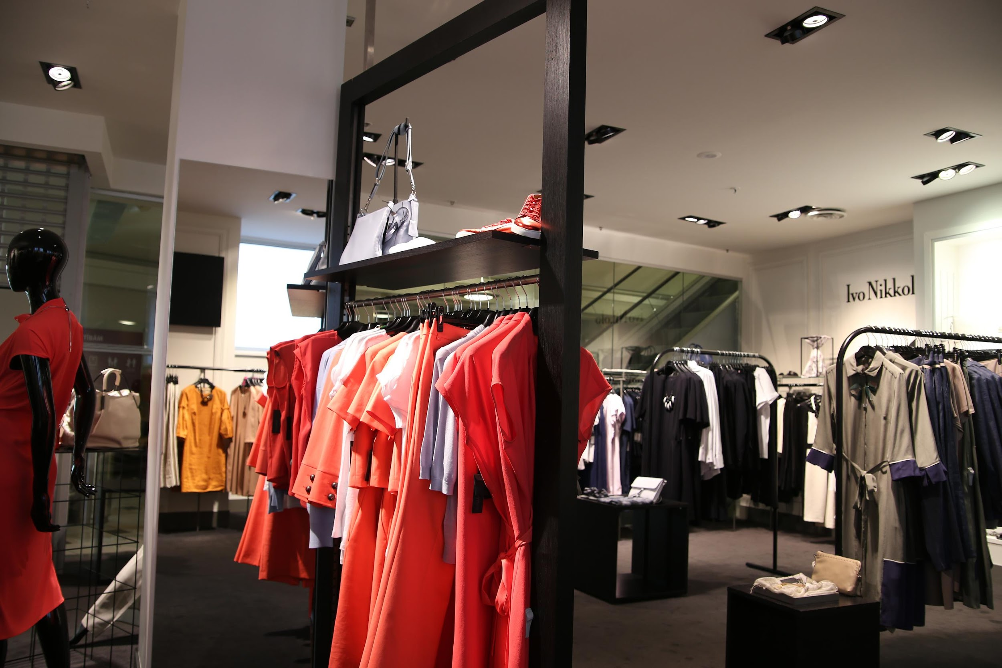


IS 675 - Deep Learning for Business Analysis
GRASP
Graph-based Hybrid Recommender Analyzing Sentiment Patterns
www.renttherunway.com
Notes:
hi

Slide 2
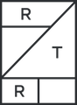
renttherunway.com
Content
Problem Statement
Sentiment Analysis
Data Preprocessing
Final Product
Recommender Systems
Conclusion

Slide 3
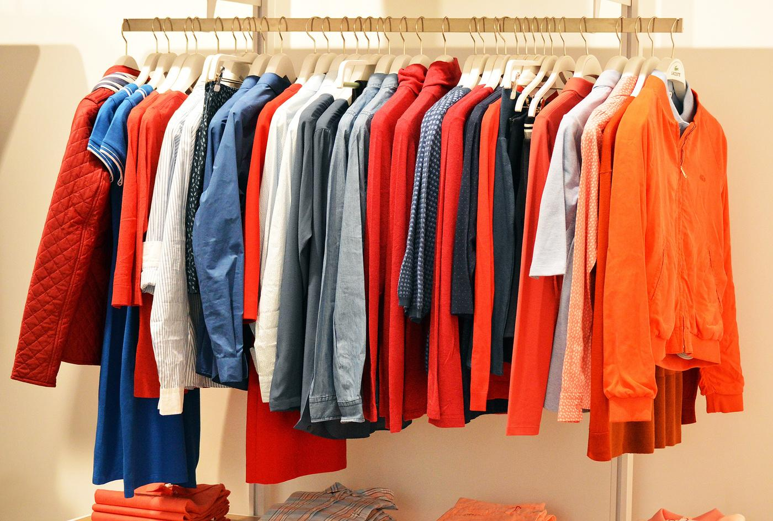


renttherunway.com
Problem Statement
Proposed Solution
Recommender System
Sentiment Analysis
Results
Conclusion
Problem statement
In a world where fashion trends change faster than Instagram stories, Rent the Runway has revolutionized how women access designer clothing. But with over 5 million customers and 90,000 items shipped daily, how can they ensure each customer finds their perfect style without drowning in a sea of options?
A system that not only knows your size and style preferences but also understands the emotions behind your fashion choices.
Research shows that personalized recommendations can increase conversion rates by 63%. For Rent the Runway, this could mean turning more of their 5 million customers into loyal subscribers. Moreover, with 74% of customers feeling frustrated when website content is not personalized our system could significantly enhance user experience and retention.

Slide 4

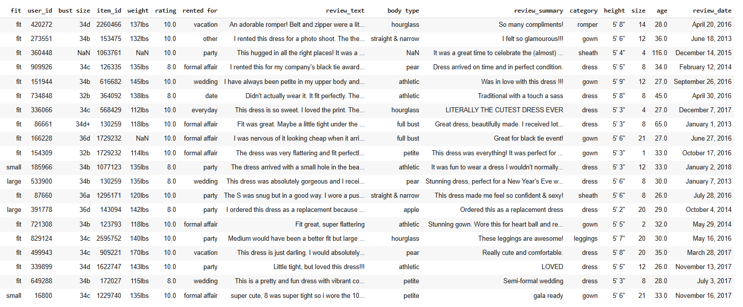




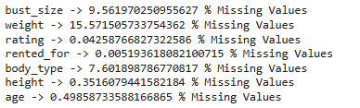
renttherunway.com
Data Preprocessing
bra size
+ cup size
Outliers?
Highly correlated variables??

Slide 5
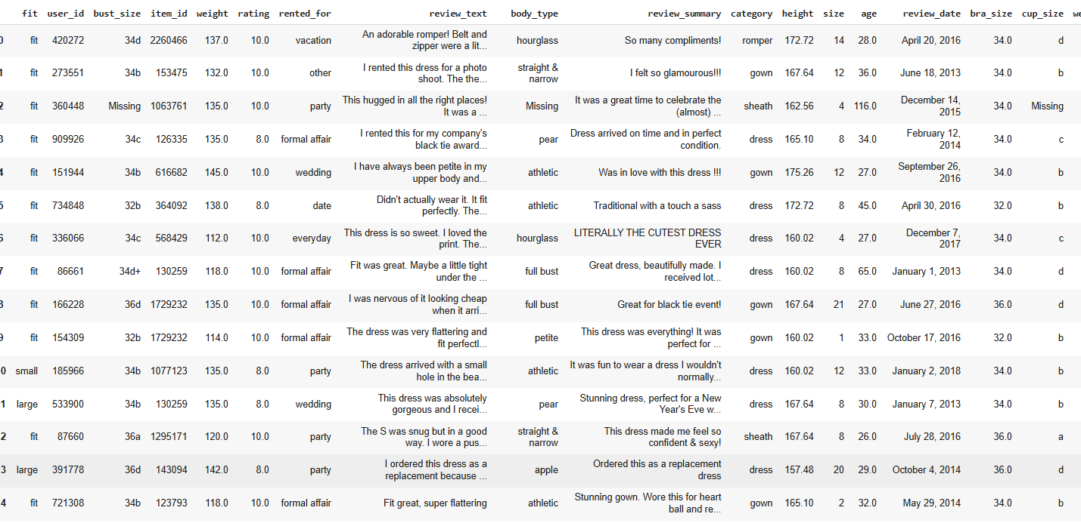


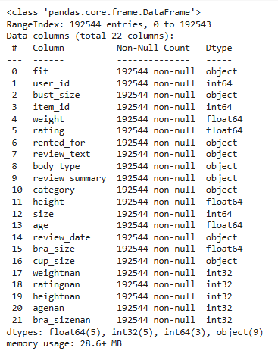
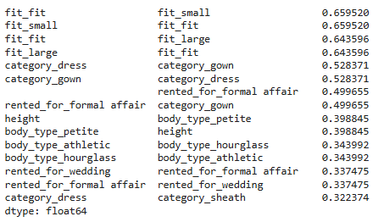


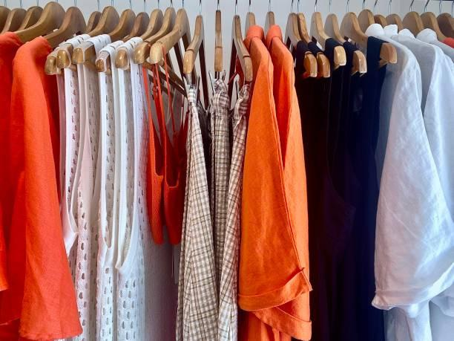
renttherunway.com
bust size fixed
Data types
Top 10 Correlation Pairs
feature
engineering
shape:
(192544, 22)
datatypes
fixed
No Empty/
NaN Values

Slide 6




Structured data component
using ML methods
Content-Based Filtering: Analyzes item features and user preferences to recommend similar products.
GNN-Based Collaborative Filtering: Utilizes Graph Neural Networks to model complex user-item interactions and capture latent relationships in the rental patterns.
Unstructured data component
Sentiment Analysis: Incorporates customer review sentiments as an additional feature to refine recommendations.
using Neural Networks
Notes:
So, we have divided our dataset into structured and unstructured components to tackle the problem in a systematic manner.
For the structured component, we designed two distinct recommender systems:
The first is a content-based filtering approach (which is a machine learning model), leveraging item attributes to recommend similar items to users, The other recommender model is designed by using Graph Neural Network model that is Neural Graph Collaborative filtering, which captures complex relationships between users and items. Futher we aim to compare both the models.
For the unstructured component, we focused on the text-based variable 'review,' where we used sentiment analysis techniques to extract sentiment scores, giving a deeper understanding of customer opinions and preferences.

Slide 7

renttherunway.com
Problem Statement
Proposed Solution
Recommender System
Sentiment Analysis
Results
Conclusion
Sentiment
Analysis
we dive deep into the emotional fabric of clothing rentals. Our sentiment analysis reveals the hidden language of fashion satisfaction, decoding thousands of customer experiences into meaningful insights.

Slide 8


Sentiment Analysis
BERT
Sentiment
Logits
Adjustments
based on keywords and length
review_text
BERT
Tokenizer()
final_predictions
BERT tokenizer uses subword-based tokenization which splits unknown words into smaller words or characters such that the model can derive some meaning from the tokens.

Slide 9
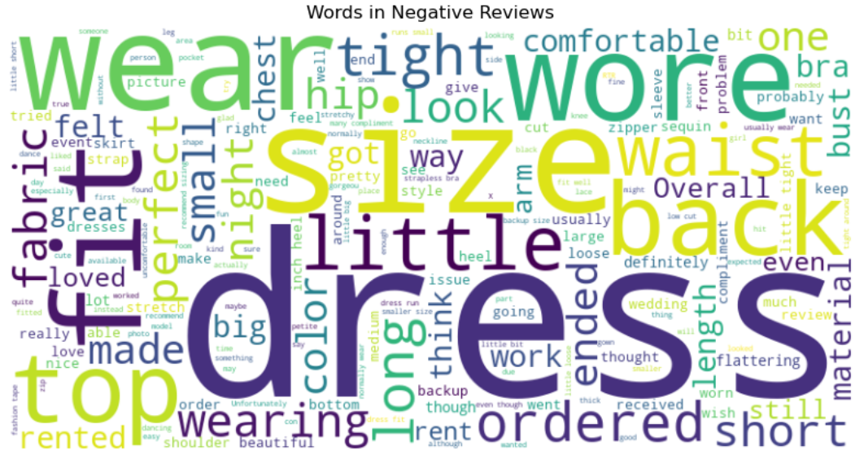
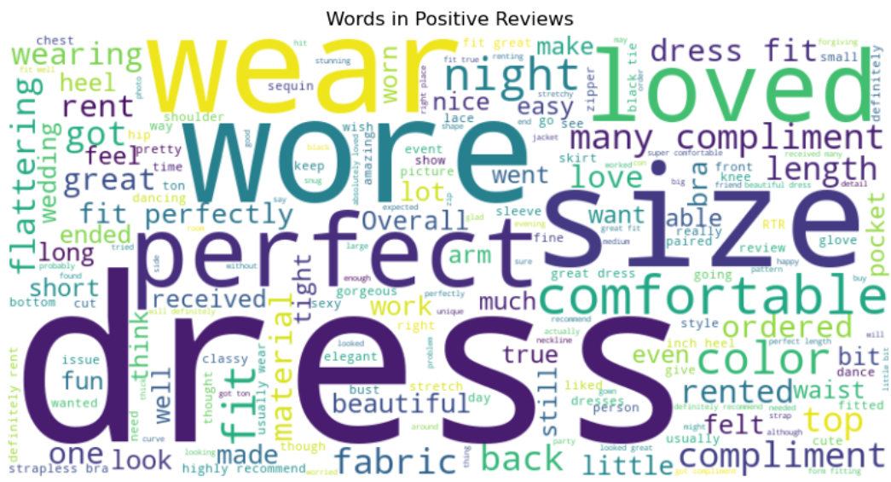
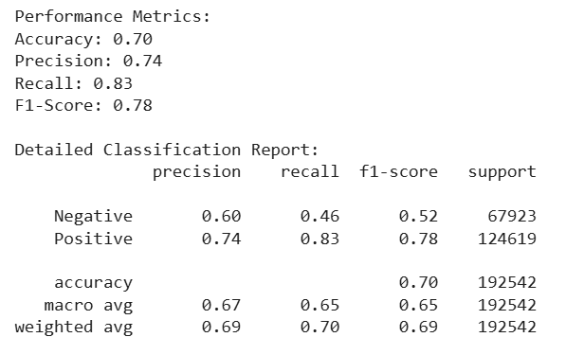
Performance Evaluation

Slide 10




renttherunway.com
Problem Statement
Proposed Solution
Recommender System
Sentiment Analysis
Results
Conclusion
Content Based Recommendation
Recommender Systems
Neural Graph Collaborative Filtering

Slide 11



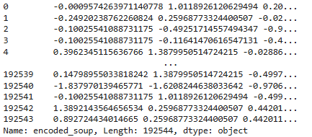
renttherunway.com
Problem Statement
Proposed Solution
Recommender System
Sentiment Analysis
Results
Conclusion
Content Based Recommendation
weight
height
size
age
bust size
Encoded soup
ANNOY index
TF-IDF matrix
rented ocassions
body type
(192544, 5489)
category
fit
review sentiments

Slide 12


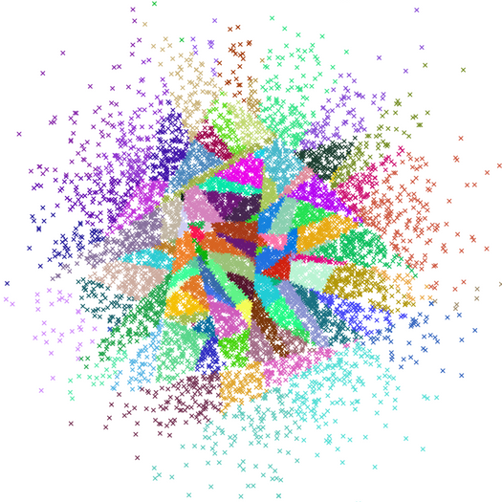
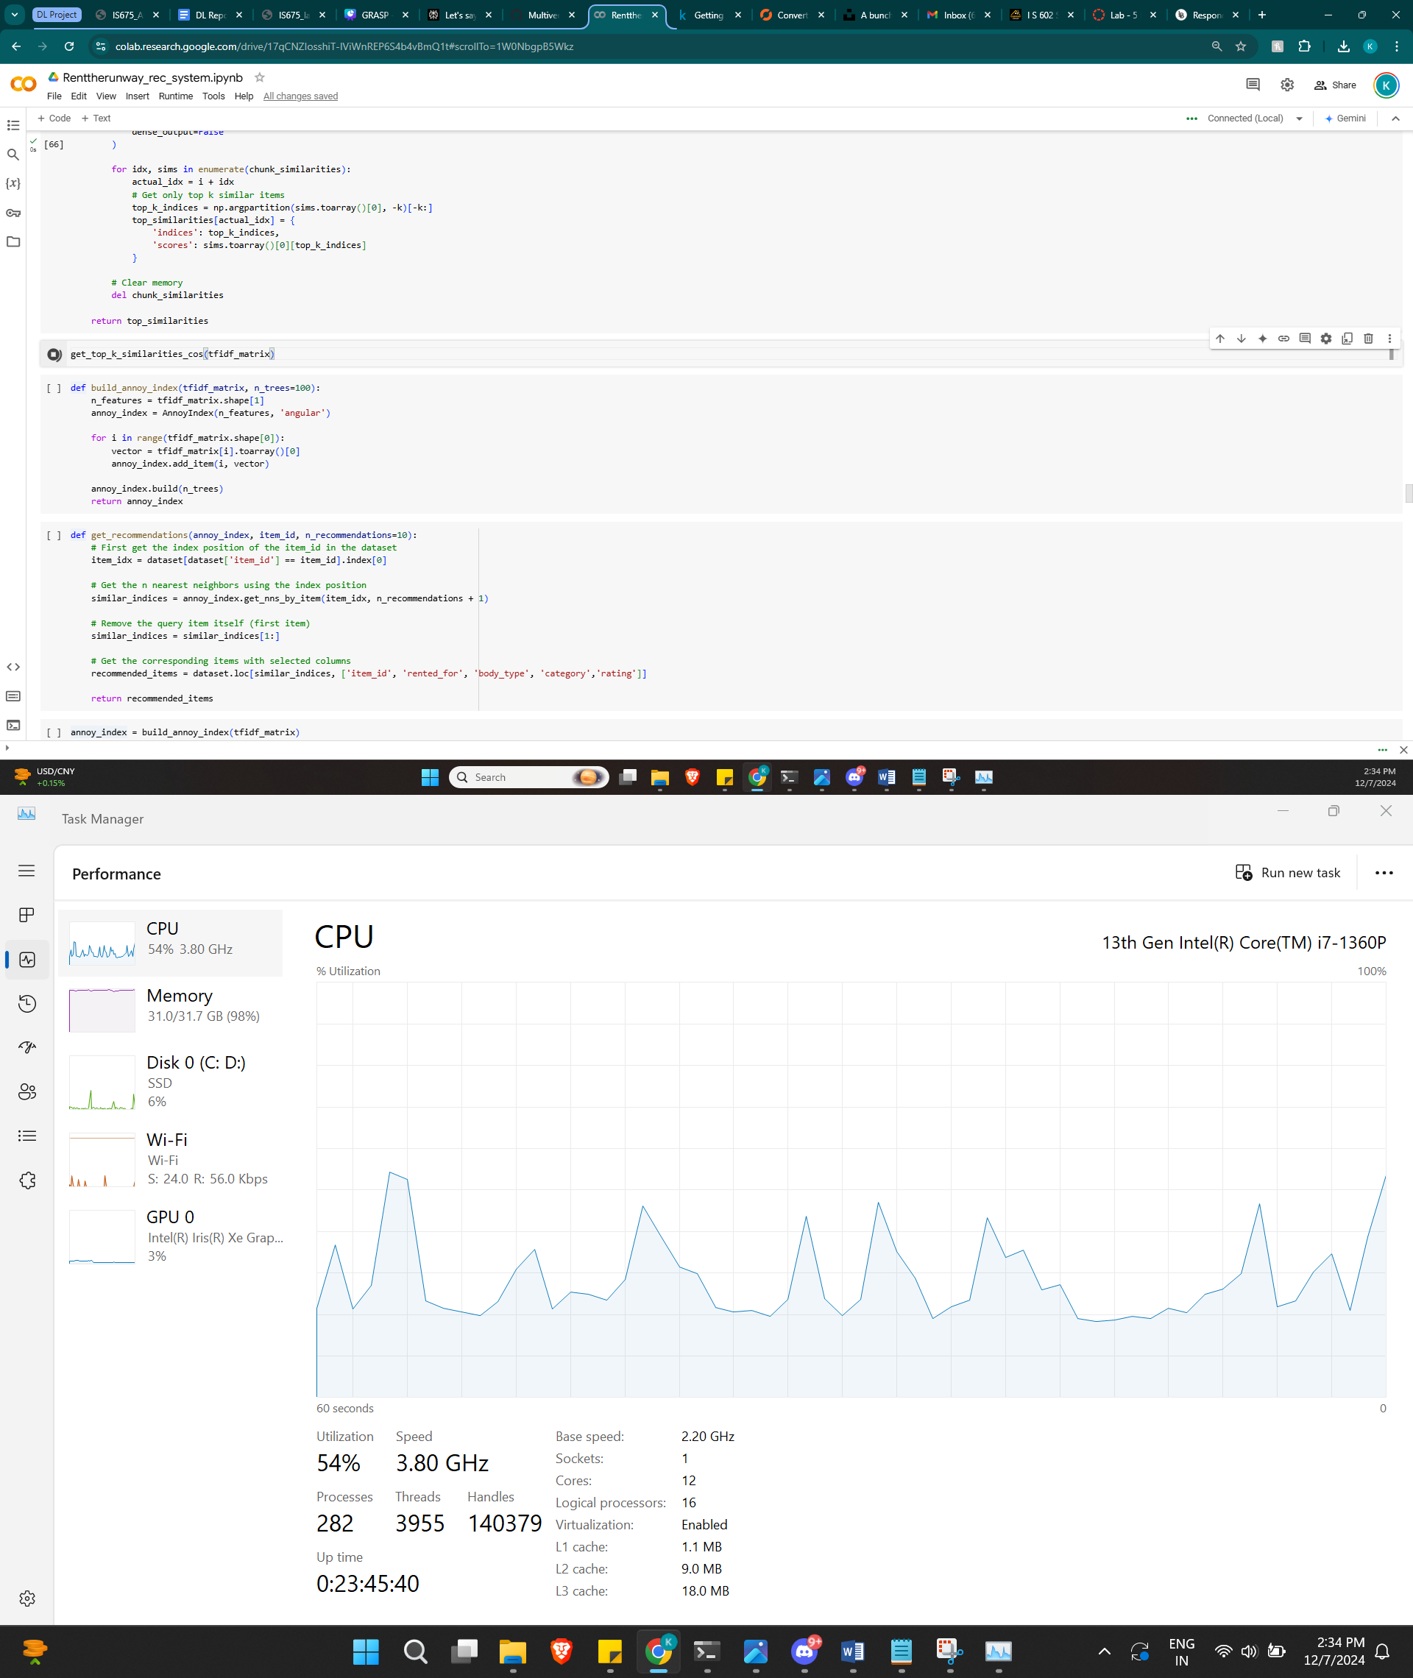
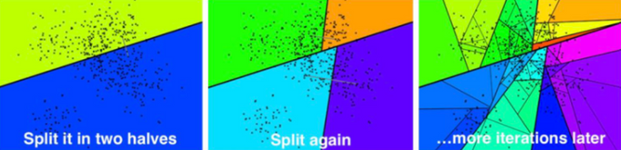
renttherunway.com
ANNOY - why? what? who?
Approximate Nearest Neighbours
Oh Yeah!
Cosine Similarity??
Approximate Near Neighbour Oh Yeah! (ANNOY) an open-source C++ library that uses algorithms to search for approximate nearest neighbors in high-dimensional spaces.
It's designed by Erik Bernhardsson in 2015, working at that time at Spotify, to be fast and memory-efficient, and is often used for large-scale, static datasets.

Slide 13
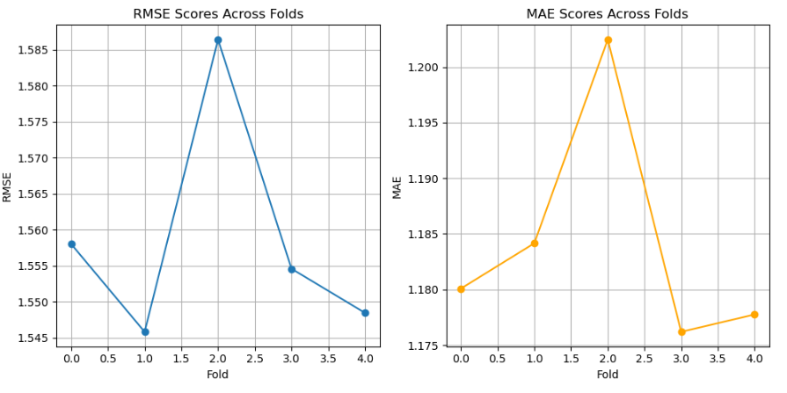
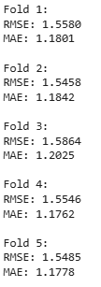
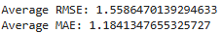
Performance Evaluation
5-fold
cross
validation:

Slide 14





renttherunway.com
Problem Statement
Proposed Solution
Recommender System
Sentiment Analysis
Results
Conclusion
Uber Eats:
Uses GraphSAGE for food discovery, resulting in a 20% improvement in recommendation metrics.
GNN
NGCF : Neural Graph Collaborative Filtering
NGCF works by constructing a user-item interaction graph, where users and items are nodes, and interactions form edges. The algorithm then performs multiple layers of embedding propagation, allowing information to flow along the graph edges.
Research has shown that NGCF outperforms traditional collaborative filtering methods, achieving significant improvements in recommendation accuracy.
Meta:
Meta uses GNNs to generate social recommendations by analyzing user connections and interactions in their social network.
Amazon:
Amazon uses GNN to generate dual product embeddings for source and target recommendations based on customer purchase patterns

Slide 15




Why GNN?
Shows promise in understanding complex user-item relationships
Handles high sparsity in data effectively as users typically rent few items from thousands of available options.
Learns dynamic fashion preferences by considering both direct interactions and neighborhood information in the bipartite user-item graph.

Slide 16

MessagePassing()

Slide 17
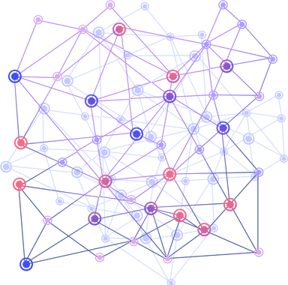
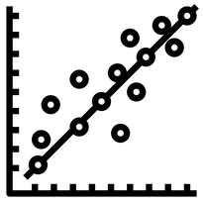


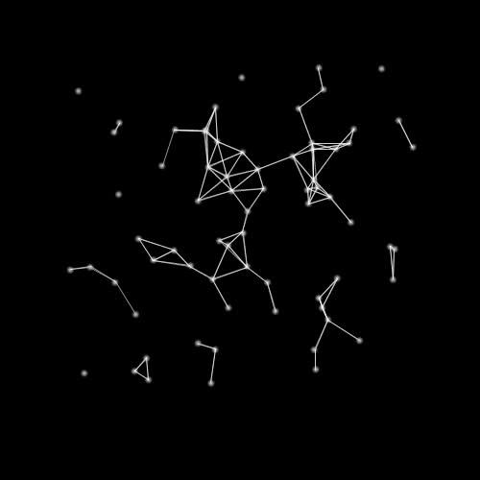
Neural Graph Collaborative Filtering Model :
Graph Layer
MessagePassing()
LeakyReLU()
(64, 64)
Graph Layer
MessagePassing()
LeakyReLU()
(64, 64)
Graph Layer
MessagePassing()
LeakyReLU()
(64, 64)
Linear Layer
ReLU()
(128, 32)
Linear Layer
ReLU()
(32, 2)
The node embeddings are updated in every layer, changing positions of all user and item nodes.

Slide 18
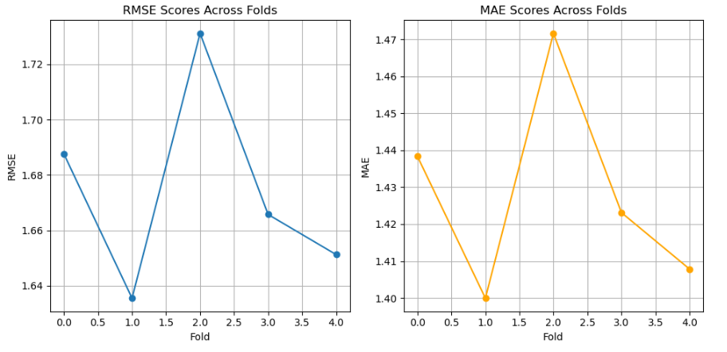
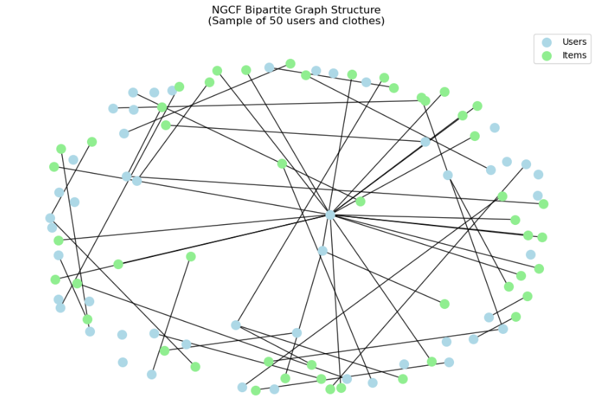
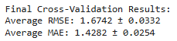
Performance Evaluation
5-fold
cross
validation:

Slide 19
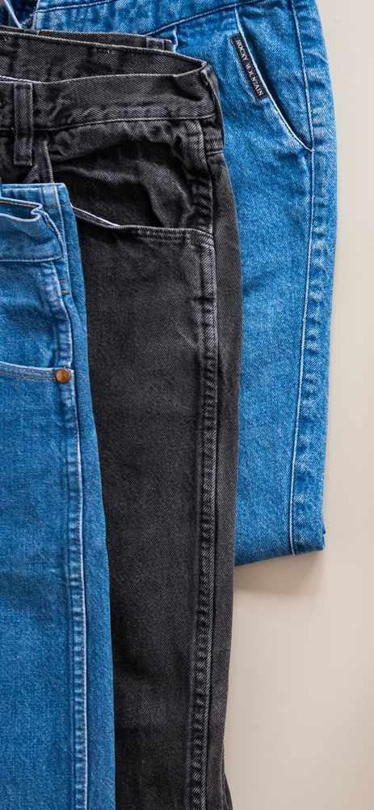
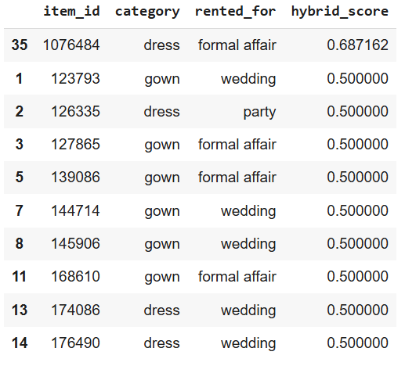

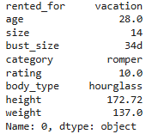
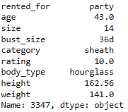
renttherunway.com
Problem Statement
Proposed Solution
Recommender System
Sentiment Analysis
Results
Conclusion
Final Product
GRASP!!
A cutting-edge recommendation system that goes beyond simply suggesting clothes—it understands emotions. A stylist that can decode the language of fashion and sentiment, potentially transforming Rent the Runway's already impressive 11.5% revenue from product recommendations.
Our Hybrid Recommendation Model calculates weighted hybrid score of scaled predicted ratings from both the models and recommends items based on that.
Slightly higher weight has been set to GNN
Original Item:
Top Suggestion:
Notes:
This is our final recommender system, where we calculated the hybrid_score. It’s basically a weighted average of both the model: content-based recommendations and Neural Graph Collaborative Filtering.
We gave more weight to the GNN model (65%) compared to content-based filtering (35%) because it’s better at finding hidden patterns and connections between users and items. This is important for our business goal, as it helps us not only understand what customers like but also discover insights to improve their experience

Slide 20

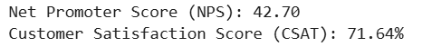
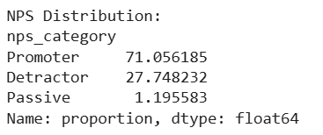
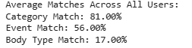
renttherunway.com
Problem Statement
Proposed Solution
Recommender System
Sentiment Analysis
Results
Conclusion
Conclusion
CSAT = (Number of satisfied customers / Total number of survey responses) x 100
Categorize reviews into Promoters, Passives, and Detractors based on sentiment strength.
It is very important to understand user’s feelings
Notes:
In our analysis, we used sentiment analysis to calculate NPS (Net Promoter Score) by identifying promoters, detractors, and passive users in our dataset.
Our Neural Graph Collaborative Filtering model did a great job at uncovering hidden connections in the dataset. Despite having 35 different clothing categories and 10 event types, the model achieved 81% category matches and 56% event matches. For instance, the 81% category match means that if someone is searching for something specific, like a sleeveless denim jacket that’s hard to find, the system can suggest a closely related option, like a full-sleeved denim jacket. This improves the user experience by providing more relevant recommendations.
In conclusion, The NGCF model proves to be a powerful model for generating meaningful insights, especially when dealing with sparse data, which is often a challenge for large companies when creating recommendation systems.

Slide 21
Thank you
Questions ?

